Slide 1


Noida Institute of Engineering and Technology, Greater Noida
Introduction
Unit: 1
DBMS ACSE0506
Neeti Taneja
AssistantProfessor CSE Department
Course Details (B Tech Vth Sem)
Neeti Taneja
DBMS
ACSE0506
Unit-1
6/15/2024
₁ 1

Slide 2
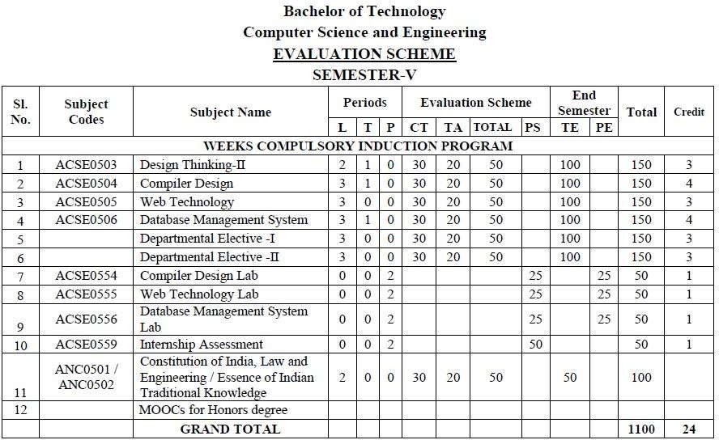
Evaluation Scheme
Neeti Taneja
DBMS
ACSE0506
Unit-1
2

Slide 3
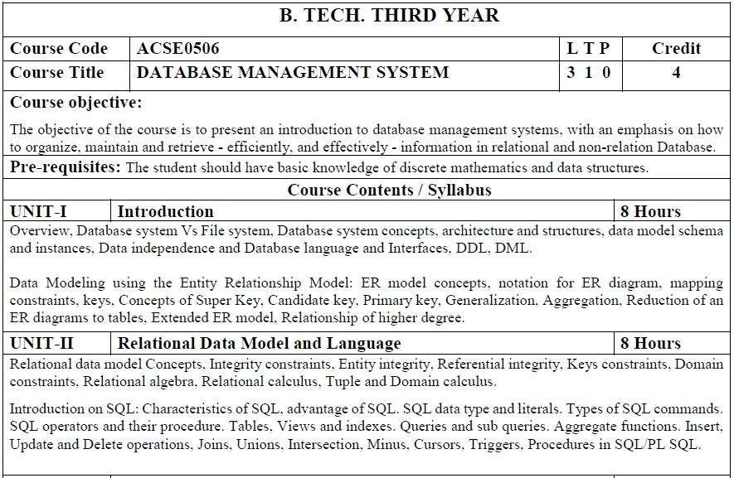
Syllabus
Neeti Taneja
DBMS
ACSE0506
Unit-1

Slide 4
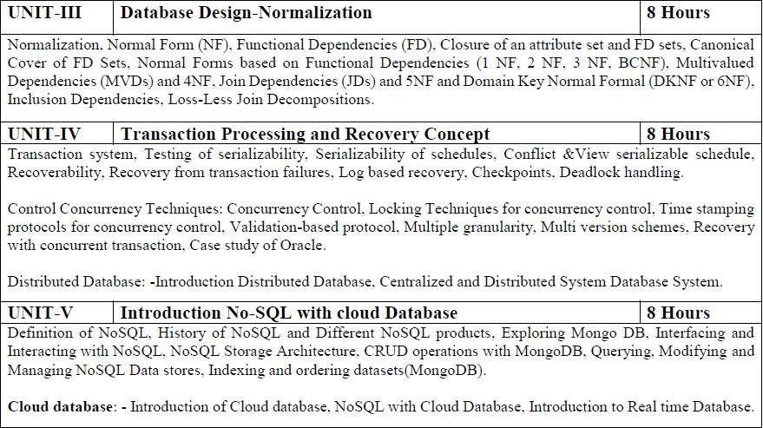
Syllabus
Neeti Taneja
DBMS
ACSE0506
Unit-1

Slide 5
Branch wise Applications
There are various application of DBMS in different fields like Railway Reservation System, Library Management System, Banking, Universities and colleges, Credit card transactions etc
Neeti Taneja
DBMS
ACSE0506
Unit-1

Slide 6
Course Objective
The objective of course is to present an introduction to database management systems, with an emphasis on how to organize, maintain and retrieve-efficiently, and effectively –information in relational and non-relational Database.
List and explain the fundamental concepts of a relational database system
Knowledge of DBMS, both in terms of use and
implementation/design.
Experience with SQL and Manipulate a database using SQL
Increased proficiency with the programming language C++.
Experience working as part of team v Experience with analysis and
design of (DB) software
Assess the quality and ease of use of data modeling and diagramming tools.
Neeti Taneja
DBMS
ACSE0506
Unit-1

Slide 7
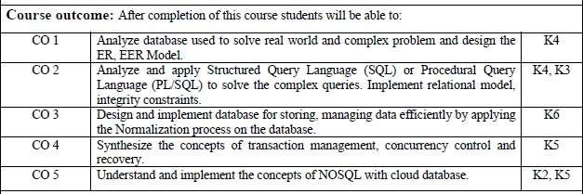
Course Outcomes
Neeti Taneja
DBMS
ACSE0506
Unit-1
7

Slide 8
Program Outcomes
Engineering Graduates will be able to:
1. Engineering knowledge: Apply the knowledge of mathematics, science, engineering fundamentals, and an engineering specialization to the solution of complex engineering problems.
2. Problem analysis: Identify, formulate, review research literature, and analyze complex engineering problems reaching substantiated conclusions using first principles of mathematics, natural sciences, and engineering sciences.
3. Design/development of solutions: Design solutions for complex engineering problems and design system components or processes that meet the specified needs with appropriate consideration for the public health and safety, and the cultural, societal, and environmental considerations.
4. Conduct investigations of complex problems: Use research-based knowledge and research methods including design of experiments, analysis and interpretation of data, and synthesis of the information to provide valid conclusions.
Neeti Taneja
DBMS
ACSE0506
Unit-1
8

Slide 9
Program Outcomes
Engineering Graduates will be able to:
5. Modern tool usage: Create, select, and apply appropriate techniques, resources, and modern engineering and IT tools including prediction and modeling to complex engineering activities with an understanding of the limitations.
6. The engineer and society: Apply reasoning informed by the contextual knowledge to assess societal, health, safety, legal and cultural issues and the consequent responsibilities relevant to the professional engineering practice.
7. Environment and sustainability: Understand the impact of the professional engineering solutions in societal and environmental contexts, and demonstrate the knowledge of, and need for sustainable development.
8. Ethics: Apply ethical principles and commit to professional ethics and responsibilities and norms of the engineering practice.
Neeti Taneja
DBMS
ACSE0506
Unit-1
9

Slide 10
Program Outcomes
Engineering Graduates will be able to:
9. Individual and team work: Function effectively as an individual, and as a member or leader in diverse teams, and in multidisciplinary settings.
10. Communication: Communicate effectively on complex engineering activities with the engineering community and with society at large, such as, being able to comprehend and write effective reports and design documentation, make effective presentations, and give and receive clear instructions.
11. Project management and finance: Demonstrate knowledge and understanding of the engineering and management principles and apply these to one’s own work, as a member and leader in a team, to manage projects and in multidisciplinary environments.
12. Life-long learning: Recognize the need for, and have the preparation and ability to engage in independent and life-long learning in the broadest context of technological change.
Neeti Taneja
DBMS
ACSE0506
Unit-1
10

Slide 11

COs and POsMapping
 | PO1 | PO2 | PO3 | PO4 | PO5 | PO6 | PO7 | PO8 | PO9 | PO10 | PO11 | PO12
KCS501.1 | 2 | 2 | 3 | 3 | 3 | 2 | 3 | 2 | 2 | 2 | 2 | 3
KCS501.2 | 3 | 3 | 3 | 2 | 2 | 2 | 2 | 2 | 2 | 2 | 2 | 3
KCS501.3 | 2 | 3 | 3 | 3 | 3 | 2 | 2 | 2 | 2 | 2 | 2 | 2
KCS501.4 | 2 | 3 | 2 | 2 | 2 | 2 | 2 | 2 | 2 | 3 | 2 | 2
KCS501.5 | 2 | 3 | 2 | 2 | 2 | 3 | 2 | 2 | 3 | 2 | 2 | 2
AVG | 2.20 | 2.80 | 2.60 | 2.40 | 2.40 | 2.20 | 2.20 | 2.00 | 2.20 | 2.20 | 2.00 | 2.40
Neeti Taneja
DBMS
ACSE0506
Unit-1
11

Slide 12
Program Specific Outcomes (PSOs)
On successful completion of graduation degree the Computer Science & Engineering graduates will be able to:
PSO1:
Design and develop the Hardware and Software systems.
PSO2:
Understand the interdisciplinary computing techniques and an ability to apply them in the design of advanced computing.
PSO3:
Understand the programming methodology, software development paradigms, design and analysis of Algorithms, Operating Systems, Digital Logic Design, Theory of
Computation, Discrete Mathematics, Compiler Design, etc.
PSO4:
To integrate & manage the various phases/components of software development projects of society.
Neeti Taneja
DBMS
ACSE0506
Unit-1
12

Slide 13

COs and PSOs Mapping
 | Program Specific Outcomes
 | PSO1 | PSO2 | PSO3 | PSO4
KCS-501.1 | 3 | 1 | 3 | 1
KCS-501.2 | 3 | 1 | 3 | 1
KCS-501.3 | 3 | 1 | 3 | 1
KCS-501.4 | 3 | 1 | 3 | 1
KCS-501.5 | 3 | 1 | 3 | 1
AVG | 3.00 | 1.00 | 3.00 | 1.00
Neeti Taneja
DBMS
ACSE0506
Unit-1
13

Slide 14
Program Educational Objectives (PEOs)
PEO1: Able to apply sound knowledge in the field of information technology to fulfill
the needs of IT industry.
PEO2: Able to design innovative and interdisciplinary systems through latest digital technologies.
PEO3: Able to inculcate professional ethics, team work and leadership for serving the society.
PEO4: Able to inculcate lifelong learning in the field of computing for successful career in organizations and R&D sectors.
Neeti Taneja
DBMS
ACSE0506
Unit-1
14

Slide 15
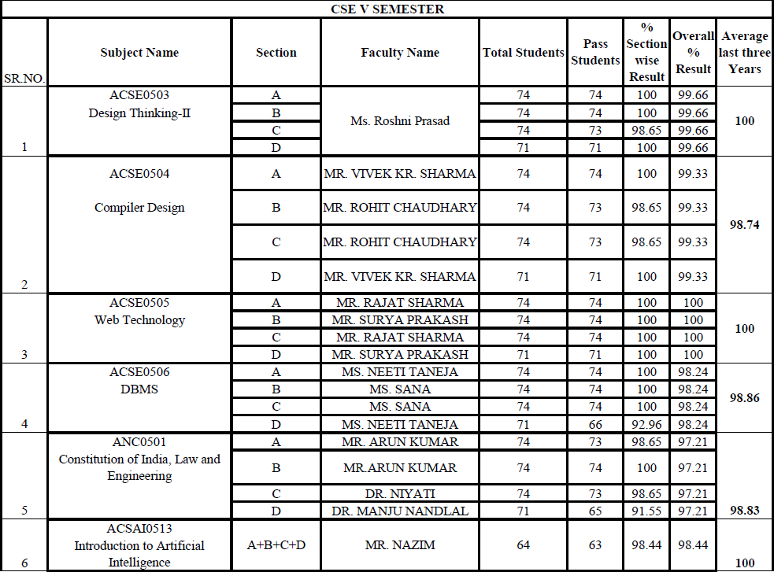
Result Analysis
Neeti Taneja
DBMS
ACSE0506
Unit-1
15

Slide 16
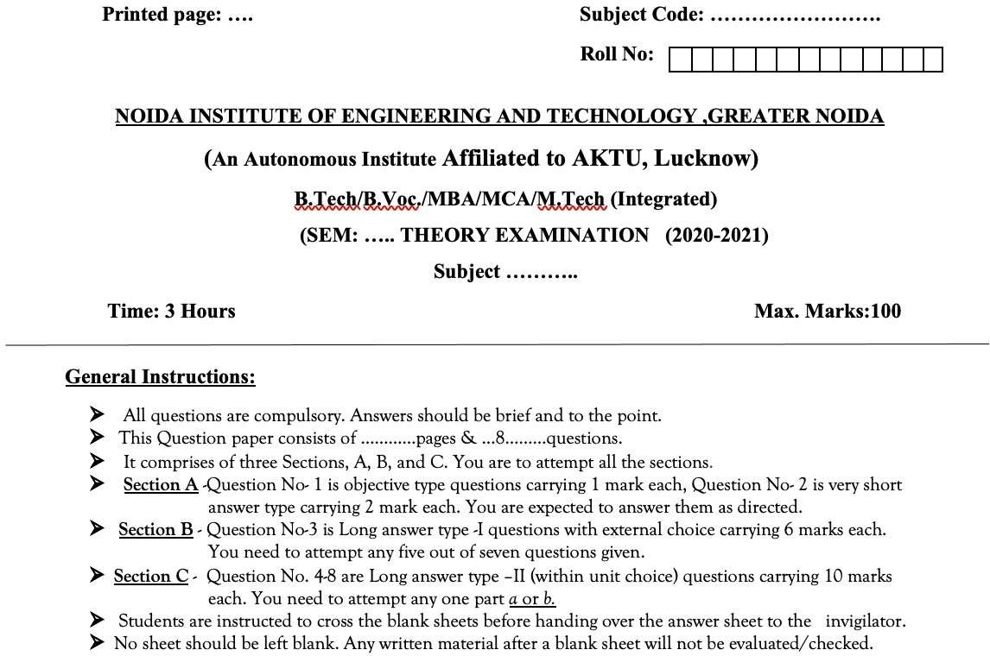
Question Paper Template
Neeti Taneja
DBMS
ACSE0506
Unit-1
16

Slide 17
Question Paper Template
 |  | SECTION – A |  | CO
1. | Attempt all parts- |  | [10×1=10]
 | 1-a. | Question- | (1)
 | 1-b. | Question- | (1)
 | 1-c. | Question- | (1)
 | 1-d. | Question- | (1)
 | 1-e. | Question- | (1)
 | 1-f. | Question- | (1)
 | 1-g. | Question- | (1)
 | 1-h. | Question- | (1)
 | 1-i. | Question- | (1)
 | 1-j. | Question- | (1)
2. | Attempt all parts- |  | [5×2=10] | CO
 | 2-a. | Question- | (2)
 | 2-b. | Question- | (2)
 | 2-c. | Question- | (2)
 | 2-d. | Question- | (2)
 | 2-e. | Question- | (2)
SECTION – B |  |  |  | CO
3. | Answer any five of the following- |  | [5×6=30]
 | 3-a. | Question- | (6)
 | 3-b. | Question- | (6)
 | 3-c. | Question- | (6)
 | 3-d. | Question- | (6)
 | 3-e. | Question- | (6)
 | 3-f. | Question- | (6)
 | 3-g. | Question- | (6)
Neeti Taneja
DBMS
ACSE0506
Unit-1
₁1₇7

Slide 18
Question Paper Template
SECTION – C |  |  |  | CO
4 | Answer any one of thefollowing- |  | [5×10=50]
 | 4-a. | Question- | (10)
 | 4-b. | Question- | (10)
5. | Answer any one of thefollowing-
 | 5-a. | Question- | (10)
 | 5-b. | Question- | (10)
6. | Answer any one of thefollowing-
 | 6-a. | Question- | (10)
 | 6-b. | Question- | (10)
7. | Answer any one of thefollowing-
 | 7-a. | Question- | (10)
 | 7-b. | Question- | (10)
8. | Answer any one of thefollowing-
 | 8-a. | Question- | (10)
 | 8-b. | Question- | (10)
Neeti Taneja
DBMS
ACSE0506
Unit-1
18

Slide 19
Prerequisite and Recap
There is No prerequisite for learning DBMS from scratch although having basic knowledge of discrete mathematics and data structure is added advantage.
Having knowledge of basic mathematics like - SUM,
etc
DIFFERENCE, AVERAGE, MEAN, MEDIAN, MODE,
will
definitely be a plus point.
Having knowledge on Set Theory will help.
The proper understanding of data structures (B and B+ trees) will help you to understand the DBMS quickly.
Neeti Taneja
DBMS
ACSE0506
Unit-1

Slide 20
Brief Introduction about the Subject
A database management system (DBMS) refers to the technology for creating and managing databases. DBMS is a software tool to organize (create, retrieve, update, and manage) data in a database.
The main aim of a DBMS is to supply a way to store up and retrieve database information that is both convenient and efficient. By data, we mean known facts that can be recorded and that have embedded meaning.
Usually, people use software such as DBASE IV or V, Microsoft ACCESS, or EXCEL to store data in the form of a database. A datum is a unit of data. Meaningful data combined to form information. Hence, information is interpreted data - data provided with semantics. MS. ACCESS is one of the most common examples of database management software.
Video Link:
www.youtube.com/watch?v=3EJlovevfcA&t=436s
Neeti Taneja
DBMS
ACSE0506
Unit-1

Slide 21


Content – Unit 1
Introduction: An overview of database system Vs file system,
database management system, Database system concept and
architecture, data model schema and instances, data independence and database language and interfaces, data definitions language, DML.
Data Modeling using the Entity Relationship Model: ER model
concepts, notation for ER diagram, mapping constraints,
Concepts of Super Key, candidate key, primary key, Generalization, aggregation, reduction of an ER diagrams to tables, extended ER model, relationship of higher degree.
Neeti Taneja
DBMS
ACSE0506
Unit-1
21

Slide 22
Unit Objective
The main objectives of database management system are data
availability, data integrity, data security, and data independence.
DDL stands for Data Definition Language. DML stands for Data Manipulation Language. DDL statements are used to create database, schema, constraints, users, tables etc. DML statement is used to insert, update or delete the records.
ER diagrams are used to analyze existing databases to find and resolve problems in logic or deployment. Drawing the diagram should reveal where it's going wrong. Business information systems: The diagrams are used to design or analyze relational databases used in business processes.
Neeti Taneja
DBMS
ACSE0506
Unit-1

Slide 23
Data & Information
What is Data?
Data : Data is the raw facts and figures. It is represented with the help of characters like alphabets(A-Z), digits(0-9) and special characters (+,-,/,*,<,>,= etc.)
Example : 26 , Rohit,
What is Information ?
Information . Processed data is called information.
It is a set of organized or classified data so that it has some meaningful values.
Example : Age 26 is information, Name of Person is Rohit
Neeti Taneja
DBMS
ACSE0506
Unit-1

Slide 24
Database
What is Database?
The term ‘Database’ is made up of two separate words, i.e. Data and base means database is a base of data.
Database is a collection of inter related data which is used to retrieve, insert and delete the data efficiently. It is also used to organize the data in the form of table, view and report etc.
Database is actually a place where related piece of information is stored and various operations can be performed on it.
Example : The college database organizes the data about the admin staff, student and faculty etc.
Neeti Taneja
DBMS
ACSE0506
Unit-1

Slide 25
Database Management System(DBMS)
A database Management System is a collection of programs that enables
users to create and maintain a database.
DBMS is a general purpose software system that facilitate the process of defining , constructing , manipulating and sharing database among various users and applications.
Defining a database involves specifying the data types, structures and
constraints for the data to be stored in the database.
Constructing the database is the process of storing the data itself on some storage medium.
Manipulating a database includes querying the database to retrieve the
information, updating the database and generating the report.
Sharing a database allows multiple users and programs to access the database concurrently.
Neeti Taneja
DBMS
ACSE0506
Unit-1

Slide 26
What is DBMS
A very large, integrated collection of related data.
Models real-world enterprise.
Entities (e.g., students, courses)
Relationships (e.g., Madonna is taking CS564)
A Database Management System (DBMS) is a software
designed to define,construct and manipulate database.
Database + Database Management System= Database System.
package
Neeti Taneja
DBMS
ACSE0506
Unit-1

Slide 27

Example Of DBMS Software
A software package/ system to facilitate the creation and maintenance of a computerized database.
Example :
Neeti Taneja
DBMS
ACSE0506
Unit-1

Slide 28
Need of Database Management System
Good data management is an essential
prerequisite to corporate success.
Data Information Knowledge Judgment Decision
Information Knowledge Judgment Decision Success
provided that data is:
complete
accurate
timely
easily available
Neeti Taneja
DBMS
ACSE0506
Unit-1

Slide 29
Why use DBMS
Data independence and efficient access.
Reduced application development time.
Data integrity and security.
Uniform data administration.
Concurrent access, recovery from crashes.
Neeti Taneja
DBMS
ACSE0506
Unit-1

Slide 30
How to maintain database in real life
Database in real life can be maintained in two ways
Manually:- By Human like as Register, paper and copy etc.
Automatic :- By Computerized like as Spread sheet, Flat file system, and
by specific database Software tools etc .
Example :- Student, University, Company, Government etc.
Neeti Taneja
DBMS
ACSE0506
Unit-1

Slide 31
Purpose of Database Systems
In the early days, database applications were built directly on top of file systems
Drawbacks of using file systems to store data:
Data redundancy and inconsistency
Multiple file formats, duplication of information in different files
Difficulty in accessing data
Need to write a new program to carry out each new task
Data isolation — multiple files and formats
Integrity problems
Integrity constraints (e.g. account balance > 0) become “buried” in program code rather than being stated explicitly
Hard to add new constraints or change existing ones
Neeti Taneja
DBMS
ACSE0506
Unit-1

Slide 32
Purpose of Database Systems (Cont.)
Drawbacks of using file systems (cont.)
Atomicity of updates
Failures may leave database in an inconsistent state with partial updates carried out
Example: Transfer of funds from one account to another
should either complete or not happen at all
Concurrent access by multiple users
Concurrent access needed for performance
Uncontrolled concurrent accesses can lead to inconsistencies
– Example: Two people reading a balance and updating it at the same time
Security problems
Hard to provide user access to some, but not all, data
Database systems offer solutions to all the above problems
Neeti Taneja DBMS ACSE0506 Unit-1
32

Slide 33
Database System Vs. File System
The database management system has a number of advantages as compared to traditional computer file-based processing approach.
Controlling Data Redundancy
In non-database systems each application program has its own private files. In this case, the duplicated copies of the same data is created in many places. In DBMS, all data of an organization is integrated into a single database file. The data is recorded in only one place in the database and it is not duplicated.
Data Consistency
By controlling the data redundancy, the data consistency is obtained. If a data item appears only once, any update to its value has to be performed only once and the updated value is immediately available to all users. If the DBMS has controlled redundancy, the database system enforces consistency.
Data Isolation problem:- In file system the data are scattered in various files, and files may have different formats. So writing new application program to retrieve the appropriate data is difficult.
Neeti Taneja
DBMS
ACSE0506
Unit-1

Slide 34
Database System Vs. File System
Sharing of Data
In DBMS, data can be shared by authorized users of the organization. The database administrator manages the data and gives rights to users to access the data. Many users can be authorized to access the same piece of information simultaneously. The remote users can also share the same data. Similarly, the data of same database can be shared between different application programs.
Atomicity Problem
In many applications , It is crucial that if failure occur, the data is restored to the consistent state that existed prior to the failure.
Atomicity means:- either all or not at all.
Control Over Concurrency
In a computer file-based system, if two users are allowed to access data simultaneously, it is possible that they will interfere with each other. For example, if both users attempt to perform update operation on the same record, then one may overwrite the values recorded by the other. Most database management systems have sub-systems to control the concurrency so that transactions are always recorded with accuracy.
Neeti Taneja
DBMS
ACSE0506
Unit-1

Slide 35
Database System Vs. File System
7.Backup and Recovery Procedures
In a computer file-based system, the user creates the backup of data regularly to protect the valuable data from damage due to failures to the computer system or application program. It is very time consuming method, if amount of data is large. Most of the DBMSs provide the 'backup and recovery' sub-systems that automatically create the backup of data and restore data if required.
Neeti Taneja
DBMS
ACSE0506
Unit-1

Slide 36
Advantages of DBMS
There are various advantages of DBMS are:-
Control database redundancy
Data Sharing
Easy maintenance
Backup and Recovery
Multiuser or multiple User interface
Neeti Taneja
DBMS
ACSE0506
Unit-1

Slide 37
Disadvantages of DBMS
There are various disadvantages of DBMS are:-
Cost of Hardware and Software
Complexity of Backup and recovery
Cost of Staff training
Cost of Data conversion
Higher impact of failure
Neeti Taneja
DBMS
ACSE0506
Unit-1

Slide 38
Database Applications
There are some examples of database applications:-
Banking: all transactions
Airlines: reservations, schedules
Universities: registration, grades
Sales: customers, products, purchases
Manufacturing: production, inventory, orders, supply
chain
Human resources: employee records, salaries, tax deductions.
Neeti Taneja
DBMS
ACSE0506
Unit-1

Slide 39
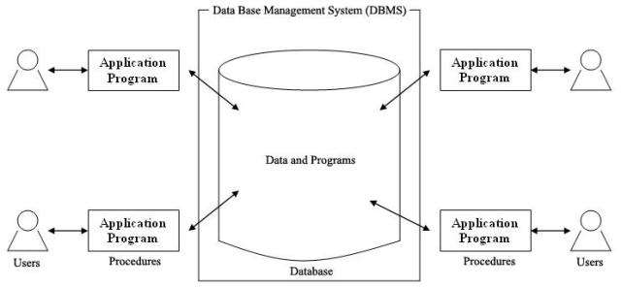
Components of DBMS
A database System involves four major components
Data
Hardware
Software
Users
Neeti Taneja
DBMS
ACSE0506
Unit-1

Slide 40
Three Views of Data
The database can be viewed from different levels of abstraction to reveal different levels of details. From a bottom-up manner, we may find that there are three levels of abstraction or views in the database.
The term Abstraction is very important here. Generally it means the amount of details you want to hide. Any entity can be seen from different perspectives and levels of complexity to make it a reveal its current amount of abstraction.
Physical level: describes how a record (e.g., customer) is stored
Logical level: describes data stored in database, and the relationships among the data.
View level: application programs hide details of data types. Views can also hide information (such as an employee’s salary) for security purposes.
Neeti Taneja
DBMS
ACSE0506
Unit-1

Slide 41
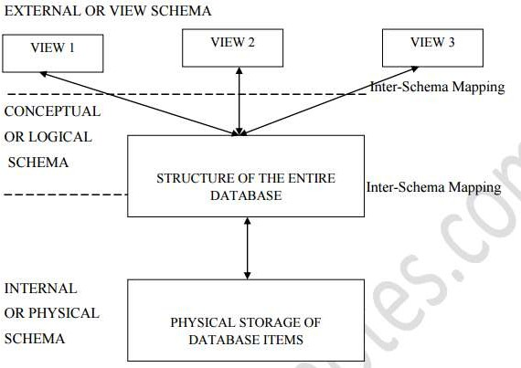
Three Views of Data
The word schema means arrangement – how we want to arrange things that we have to store. The diagram above shows the three different schemas used in DBMS, seen from different levels of abstraction.
Instance – the actual content of the database at a particular point in time. Analogous to the value of a variable.
Neeti Taneja
DBMS
ACSE0506
Unit-1

Slide 42
Schema
Schema
A database schema is the skeleton structure that represents the logical view of the entire database.
It is not expected to change frequently.
When we define a new database we specify its database schema.
It defines how the data is organized and how the relations among them are associated.
It formulates all the constraints that are to be applied on the data.
Example:
Roll _No | S_name | Age | Address | Pincode
Neeti Taneja
DBMS
ACSE0506
Unit-1

Slide 43
Instance
Instance
Database Instance change overtime as information is inserted and deleted. The collection of information stored in the database at a particular moment is called an instance of the database.
It is also called database state or snapshot.( actual content of the database at a particular point in time)
For example, lets say we have a single table student in the database, today the table has 100 records, so today the instance of the database has 100 records. Lets say we are going to add another 100 records in this table by tomorrow so the instance of database tomorrow will have 200 records in table. In short, at a particular moment the data stored in database is called the instance, that changes over time when we add or delete data from the database.
Neeti Taneja
DBMS
ACSE0506
Unit-1

Slide 44
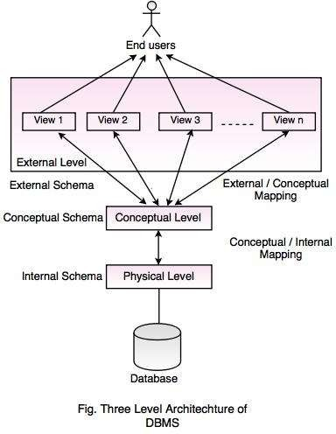
Three schema architecture
Neeti Taneja
DBMS
ACSE0506
Unit-1

Slide 45
Three Schemas of Data
Internal Schema
The lowest level, called the Internal or Physical schema, deals with the description of how raw data items (like 1, ABC, KOL, H2 etc.) are stored in the physical storage (Hard Disc, CD, Tape Drive etc.).
It also describes the data type of these data items, the size of the items in the storage media, the location (physical address) of the items in the storage device and so on.
This schema is useful for database application developers and database
administrator.
Conceptual or Logical Schema
The middle level is known as the Conceptual or Logical Schema, and deals with the structure of the entire database. Please note that at this level we are not interested with the raw data items anymore, we are interested with the structure of the database.
Neeti Taneja
DBMS
ACSE0506
Unit-1

Slide 46
Three Schemas of Data
This means we want to know the information about the attributes of each table, the common attributes in different tables that help them to be combined, what kind of data can be input into these attributes, and so on.
Conceptual or Logical schema is very useful for database administrators whose responsibility is to maintain the entire database. External or View Schema.
This is targeted for the end users. Now, an end user does not need to know everything about the structure of the entire database, rather than the amount of details he/she needs to work with. We may also not allow this for the purpose of security, where sensitive information must remain hidden from unwanted persons.
The database administrator may want to create custom made tables, keeping in mind the specific kind of need for each user. These tables are also known as virtual tables, because they have no separate physical existence. They are created dynamically for the users at runtime.
Neeti Taneja
DBMS
ACSE0506
Unit-1

Slide 47
Levels of Abstraction
Physical Schema/Level: describes how a record (e.g., customer) is
stored.
Logical Schema/Level: describes data stored in database, and the relationships among the data.
type customer = record
customer_id : string; customer_name : string; customer_street : string; customer_city : string;
end;
External Schema/Level: application programs hide details of data types. Views can also hide information (such as an employee’s salary) for security purposes.
Sana Anjum
DBMS
Neeti Taneja DBMS
47

Slide 48
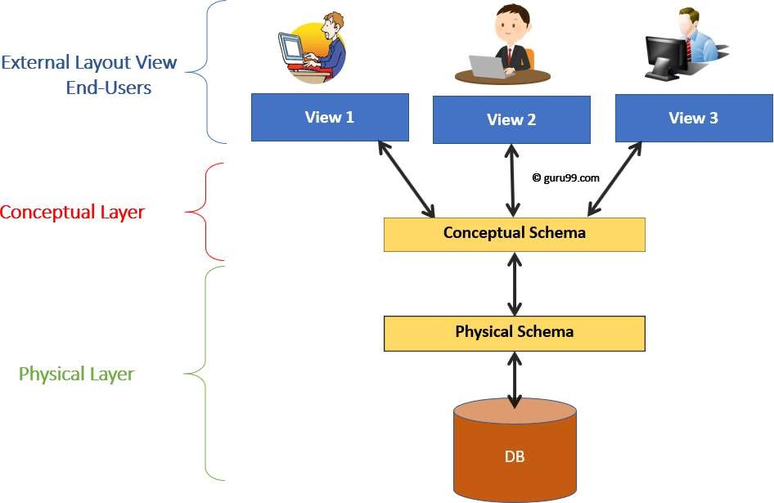
Levels of Abstraction
Three Schema Architecture for a Database System
Neeti Taneja
DBMS
ACSE0506
Unit-1
48

Slide 49
Example: University Database
Physical schema:
Relations stored as unordered files.
Index on first column of Students.
Conceptual schema:
Students(sid: string, name: string, login: string, age: integer, gpa:real)
Courses(cid: string, cname:string, credits:integer)
Enrolled(sid:string, cid:string, grade:string)
External Schema (View):
View1- Course_info(cid:string,enrollment:integer)
View2-studeninfo(id:int. name:string)
Neeti Taneja
DBMS
ACSE0506
Unit-1
49

Slide 50
Database Users
End Users: These are:
Casual Users: These are the users who communicate with the database for little period of time. They are occasionally using the database. So these are the temporary users.
Parametric Or Naive Users: These are the users who communicate with the database for a regular period. Their main job is to constantly querying and updating the database using standard queries.
Sophisticated End Users: These are engineers, scientists, business analysts who are familiar with the database and when they want to use the database, they use it regularly and when they don’t want then they are temporarily using .
Stand alone users: These are the users who maintain their personal database using ready made software which is available in the market easily and provide the menu based interface through which they can easily use the database.
Neeti Taneja
DBMS
ACSE0506
Unit-1
50

Slide 51
Database Administrator
Coordinates all the activities of the database system
– has a good understanding of the enterprise’s
resources and needs.
Database administrator's duties include:
Storage structure and access method definition
Schema and physical organization modification
Granting users authority to access the database
Backing up data
Monitoring performance and responding to changes
Database tuning
information
Neeti Taneja
DBMS
ACSE0506
Unit-1
51

Slide 52
Data Independence
Data Independence is defined as a property of DBMS that helps you to change the Database schema at one level of a database system without requiring to change the schema at the next higher level.
Data independence helps you to keep data separated from all programs that make use of it.
In DBMS there are two types of data independence
Physical data independence
Logical data independence.
One of the most important benefits of using a DBMS!
Neeti Taneja
DBMS
ACSE0506
Unit-1
52

Slide 53
Physical Data Independence
Physical data independence can be defined as the capacity to change the internal schema without having to change the conceptual schema.
If we do any changes in the storage size of the database system server, then the Conceptual structure of the database will not be affected.
Physical data independence is used to separate conceptual levels
from the internal levels.
Physical data independence occurs at the logical interface level.
Neeti Taneja
DBMS
ACSE0506
Unit-1
53

Slide 54
Physical Data Independence (contd..)
Due to Physical independence, any of the below change will not affect the conceptual layer.
Using a new storage device like Hard Drive or Magnetic Tapes
Modifying the file organization technique in the Database
Switching to different data structures.
Changing the access method.
Modifying indexes.
Changes to compression techniques or hashing algorithms.
Change of Location of Database from say C drive to D Drive
Neeti Taneja
DBMS
ACSE0506
Unit-1

Slide 55
Logical Data Independence
Logical data independence refers characteristic of being able to change the conceptual schema without having to change the external schema.
Logical data independence is used to separate the external level
from the conceptual view.
If we do any changes in the conceptual view of the data, then the
user view of the data would not be affected.
Logical data independence occurs at the user interface level.
Neeti Taneja
DBMS
ACSE0506
Unit-1

Slide 56
Logical Data Independence (contd..)
Due to Logical independence, any of the below change will not affect the external layer.
Add/Modify/Delete a new attribute, entity or relationship is
possible without a rewrite of existing application programs
Merging two records into one
Breaking an existing record into two or more records
Neeti Taneja
DBMS
ACSE0506
Unit-1

Slide 57
Structure of DBMS
Structure of Database Management System is also referred to as Overall System Structure or Database Architecture but it is different from the tier architecture of Database.
The database system is divided into three components:
Query Processor
Storage Manager
Disk Storage
Query Processor: It interprets the requests (queries) received from end user via an application program into instructions.
Query Processor contains the following components –
DML Compiler, DDL Interpreter, Embedded DML Pre-compiler, Query Optimizer.
Neeti Taneja
DBMS
ACSE0506
Unit-1

Slide 58
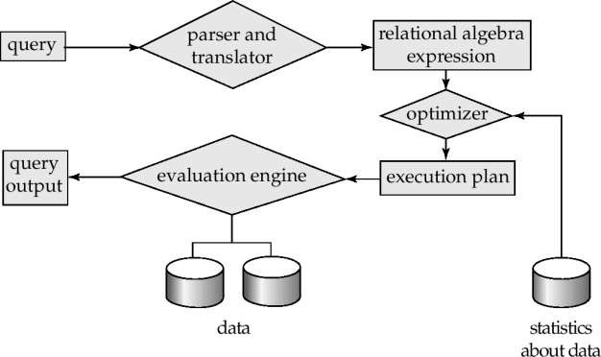
Query Processing
Parsing and translation
Optimization
Evaluation
Neeti Taneja
DBMS
ACSE0506
Unit-1

Slide 59
Query Processing (Cont.)
Alternative ways of evaluating a given query
Equivalent expressions
Different algorithms for each operation
Cost difference
between a good and a bad way
of evaluating a
query can be enormous
Need to estimate the cost of operations
Depends critically on statistical information about relations which the database must maintain
Need to estimate statistics for intermediate results to compute cost of complex expressions
Neeti Taneja
DBMS
ACSE0506
Unit-1
59

Slide 60
Storage Management
Storage manager is a program module that provides the interface
between the low-level data stored in the database
application programs and queries submitted to the system.
The storage manager is responsible to the following tasks:
Interaction with the file manager
Efficient storing, retrieving and updating of data
Issues:
Storage access
File organization
Indexing and hashing
and the
Neeti Taneja
DBMS
ACSE0506
Unit-1

Slide 61
Disk Management
Disk Storage: It contains the following components –
Data Files, Data Dictionary, Indices
A transaction is a collection of operations that performs a single logical
function in a database application
Transaction-management component ensures that the database remains in a consistent (correct) state despite system failures (e.g., power failures and operating system crashes) and transaction failures.
Concurrency-control manager controls the interaction among the concurrent transactions, to ensure the consistency of the database.
Neeti Taneja
DBMS
ACSE0506
Unit-1

Slide 62
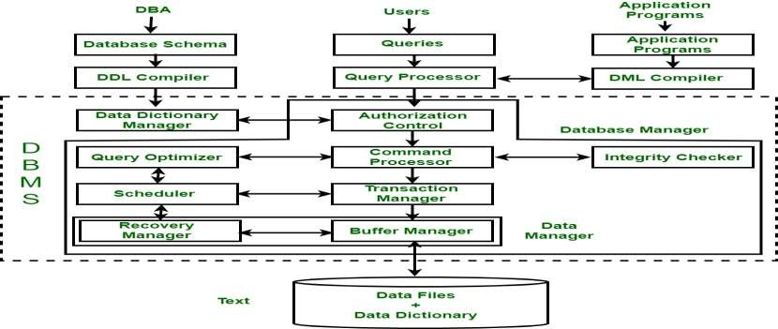
Structure of DBMS
The structure of a DBMS can be divided into three main components:
The Internal Level - This level represents the physical storage of data in the database.
The Conceptual Level - This level represents the logical view of the database.
The External Level - This level represents the user’s view of the database.
Neeti Taneja
DBMS
ACSE0506
Unit-1

Slide 63
Summary
DBMS used to maintain, query large datasets.
Benefits include recovery from system crashes, concurrent access, quick
application development, data integrity and security.
Levels of abstraction give data independence.
A DBMS typically has a layered architecture.
DBAs hold responsible jobs and are well-paid! ☺
DBMS R&D is one of the broadest, most exciting areas in CS.
Neeti Taneja
DBMS
ACSE0506
Unit-1

Slide 64
Short Quiz
What is the full form of DBMS?
Data of Binary Management System
Database Management System
Database Management Service
Data Backup Management System
What is a database?
Organized collection of information that cannot be
accessed, updated, and managed
Collection of data or information without organizing c)Organized collection of data or information that can be accessed, updated, and managed
d) Organized collection of data that cannot be updated
Neeti Taneja
DBMS
ACSE0506
Unit-1
64

Slide 65
Topic – Data models Objective
Data Model gives us an idea that how the final system will look like
after its complete implementation.
It defines the data elements and the relationships between the data elements.
Data Models are used to show how data is stored, connected,
accessed and updated in the database management system.
Neeti Taneja
DBMS
ACSE0506
Unit-1

Slide 66
Data Models
A data model is a collection of concepts for describing data.
Categories of Data Models :-
High level or Conceptual Data Model
Concept of entities, attributes and relationships
Low level or physical Data Model
Details of how data is stored in computer
Representational Data Model
Traditional commercial DBMS so called legacy data models-
network or hierarchical models.
Neeti Taneja
DBMS
ACSE0506
Unit-1

Slide 67
Data Models
A collection of tools for describing
Data
Data relationships
Data semantics
Data constraints
Relational model
Entity-Relationship data model (mainly for database design)
Object-based data models (Object-oriented and Object- relational)
Semi structured data model (XML)
Other older models:
Network model
Hierarchical model
Neeti Taneja
DBMS
ACSE0506
Unit-1

Slide 68
Hierarchical Model
Hierarchical Model was the first DBMS model. This model organizes the data in the hierarchical tree structure. The hierarchy starts from the root which has root data and then it expands in the form of a tree adding child node to the parent node.
Features of a Hierarchical Model
One-to-many relationship: The data here is organized in a tree-like structure where the one-to-many relationship is between the data types. Also, there can be only one path from parent to any node.
Parent-Child Relationship: Each child node has a parent node but a parent node can have more than one child node. Multiple parents are not allowed.
Deletion Problem: If a parent node is deleted then the child node is automatically deleted.
Pointers: Pointers are used to link the parent node with the child node and are used to navigate between the stored data.
12/23/2024

Slide 69
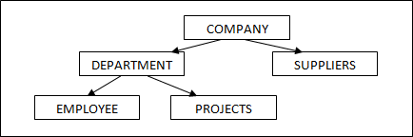
Hierarchical Model (Example)
12/23/2024

Slide 70
Continued
Example :- Company has its department, its suppliers, its employees, different projects of the company etc are the different entities we need to take care of. If we observe each of the entity they have parent –child relationship.
In above example , Company is the parent and rests of them are its children. Department has employees and projects as its children and so on. This type of data modeling is called hierarchical data model.
One company has multiple departments (1:N), one company has multiple suppliers (1:N),one department has multiple employees (1:N), each department has multiple projects(1:N)
Complexity in Hierarchal diagram:-If we have M:N relationships, then we have to duplicate the entities and show it in the diagram. For example, if a project in the company involves multiple departments, then our hierarchical representation changes as below:-
12/23/2024

Slide 71
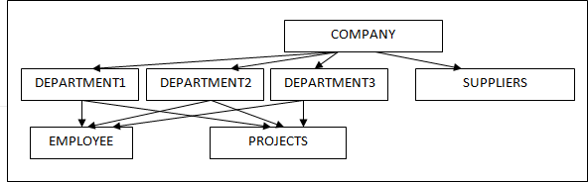
Continued
12/23/2024

Slide 72
Continued
Major problem in Hierarchical Model
Redundancy: – When data is stored in a flat file, there might be repetition of same data multiple times and any changes required for the data will need to change in all the places in the flat file. Missing to update at any one place will cause incorrect data. This kind redundancy is solved by hierarchical model to some extent. (1:M)
Since records are grouped under related table, it solves the flat file redundancy issue. But look at the many to many relationship examples given above. In such case, we have to store same project information for more than one department. This is duplication of data and hence a redundancy. So, this model does not reduce the redundancy issue to a significant level.(M:M)
12/23/2024

Slide 73
Advantages and Disadvantages
Advantages of Hierarchical Model
It is very simple and fast to traverse through a tree-like structure.
It helps to address the issues of flat file data storage. In flat files, data will be scattered and there will not be any proper structuring of the data. This model groups the related data into tables and defines the relationship between the tables, which is not addressed in flat files.
Any change in the parent node is automatically reflected in the child node so, the integrity of data is maintained.
Disadvantages of Hierarchical Model
Redundancy
Complex relationships are not supported.
As it does not support more than one parent of the child node so if we have some complex relationship where a child node needs to have two parent node then that can't be represented using this model.
If a parent node is deleted then the child node is automatically deleted.
12/23/2024

Slide 74
Network Model
This is the enhanced version of hierarchical data model. It is designed to address the drawbacks of the hierarchical model. It helps to address M:N relationship. This data model is also represented as hierarchical, but this model will not have single parent concept. Any child in the tree can have multiple parents here. It was the most popular model before the relational model.
Features of a Network Model
Ability to Merge more Relationships: In this model, as there are more relationships so data is more related. This model has the ability to manage one-to-one relationships as well as many-to-many relationships.
Many paths: As there are more relationships so there can be more than one path to the same record. This makes data access fast and simple.
Circular Linked List: The operations on the network model are done with the help of the circular linked list. The current position is maintained with the help of a program and this position navigates through the records according to the relationship.
12/23/2024

Slide 75
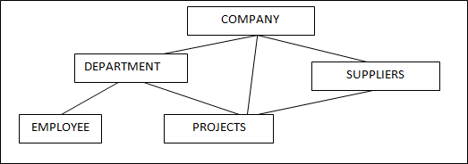
Network Model (Example)
12/23/2024

Slide 76
Example (Continued)
Let us revisit our company example. A company has different projects and departments in the company own those projects. Even suppliers of the company give input for the project.
Here Project has multiple parents and each department and supplier
have multiple projects.
12/23/2024

Slide 77
Advantages
Advantages of Network Model
The data can be accessed faster as compared to the hierarchical model. This is because the data is more related in the network model and there can be more than one path to reach a particular node. So the data can be accessed in many ways.
As there is a parent-child relationship so data integrity is present.
Any change in parent record is reflected in the child record.
12/23/2024

Slide 78
Disadvantages
Disadvantages of Network Model
As more and more relationships need to be handled the system might get complex. So, a user must be having detailed knowledge of the model to work with.
If there is any requirement for the changes to the entities, it requires entire changes to the database. There is no independence between any objects. Hence any changes to any of the object will need changes to the whole model. Hence difficult to manage.
It would be little difficult to design the relationship between the entities, since all the entities are related in some way. It requires thorough practice and knowledge about the designing.
12/23/2024

Slide 79
Short Quiz
Which of the following is known as a set of entities of the same type that
share same properties, or attributes?
Relation set
Tuples
Entity set
Entity Relation model
The values appearing in given attributes of any tuple in the referencing relation must likewise occur in specified attributes of at least one tuple in the referenced relation, according to
integrity constraint.
Referential
Primary
Referencing
Specific
Neeti Taneja
DBMS
ACSE0506
Unit-1
79

Slide 80
Topic- Database Language Objective
DDL stands for Data Definition Language. DML stands for Data Manipulation Language. DDL statements are used to create database, schema, constraints, users, tables etc. DML statement is used to insert, update or delete the records.
DCL (Data Control Language) includes commands like GRANT and
REVOKE, which are useful to give “rights & permissions.”
Transaction control language or TCL commands deal with the transaction within the database.
Data Query Language (DQL) is used to fetch the data from the database.
80

Slide 81
DATA BASE LANGUAGE
A DBMS has appropriate languages and interfaces to express
database queries and updates.
Database languages can be used to read, store and update the data in the database.
Two classes of languages
– Procedural – user specifies what data is required and how to get
those data
– Declarative (nonprocedural) – user specifies
required without specifying how to get those data
SQL is the most widely used query language
what data is
Neeti Taneja
DBMS
ACSE0506
Unit-1

Slide 82
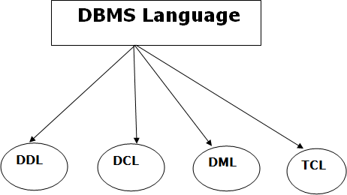
DATA BASE LANGUAGE
Neeti Taneja
DBMS
ACSE0506
Unit-1

Slide 83
Data Definition Language (DDL)
DDL stands for Data Definition Language. It is used to define
database structure or pattern.
It is used to create schema, tables, indexes, constraints, etc. in the database.
Using the DDL statements, you can create the skeleton of the
database.
Data definition language is used to store the information of metadata like the number of tables and schemas, their names, indexes, columns in each table, constraints, etc.
Neeti Taneja
DBMS
ACSE0506
Unit-1

Slide 84
Data Definition Language (DDL)
Here are some tasks that come under DDL:
Create: It is used to create objects in the database.
Alter: It is used to alter the structure of the database.
Drop: It is used to delete objects from the database.
Truncate: It is used to remove all records from a table.
Rename: It is used to rename an object.
Comment: It is used to comment on the data dictionary.
These commands are used to update the database schema that's why
they come under Data definition language.
Neeti Taneja
DBMS
ACSE0506
Unit-1

Slide 85
Data Manipulation Language (DML)
DML stands for Data Manipulation Language. It is used for accessing
and manipulating data in a database. It handles user requests.
Here are some tasks that come under DML:
Select: It is used to retrieve data from a database.
Insert: It is used to insert data into a table.
Update: It is used to update existing data within a table.
Delete: It is used to delete all records from a table.
Merge: It performs UPSERT operation, operations.
Call: It is used to call a structured query language or a Java
subprogram.
Explain Plan: It has the parameter of explaining data.
Lock Table: It controls concurrency.
i.e., insert or update
Neeti Taneja
DBMS
ACSE0506
Unit-1

Slide 86
Data Control Language (DCL)
DCL stands for Data Control Language. It is used to retrieve the
stored or saved data.
The DCL execution is transactional. It also has rollback parameters. (But in Oracle database, the execution of data control language does not have the feature of rolling back.)
Here are some tasks that come under DCL:
Grant: It is used to give user access privileges to a database.
Revoke: It is used to take back permissions from the user.
There are the following operations which have the authorization of
Revoke:
CONNECT, INSERT, USAGE, EXECUTE, DELETE, UPDATE and SELECT.
Neeti Taneja
DBMS
ACSE0506
Unit-1

Slide 87
Transaction Control Language (TCL)
TCL is used to run the changes made by the DML statement. TCL
can be grouped into a logical transaction.
Here are some tasks that come under TCL:
Commit: It is used to save the transaction on the database.
Rollback: It is used to restore the database to original since the
last Commit.
Neeti Taneja
DBMS
ACSE0506
Unit-1

Slide 88
Short Quiz
The ability to query data, as well as insert, delete, and alter tuples, is
offered by
TCL (Transaction Control Language)
DCL (Data Control Language)
DDL (Data Definition Langauge)
DML (Data Manipulation Langauge)
Which command is used to remove a relation from an SQL?
Drop table
Delete
Purge
Remove
Neeti Taneja
DBMS
ACSE0506
Unit-1

Slide 89
Topic- Relational Model and SQL Objective
The purpose of the relational model is to provide a declarative method for specifying data and queries: users directly state what information the database contains and what information they want from it.
One of the major goals of Object relational data model is to close the gap between relational databases and the object oriented practises frequently used in many programming languages such as C++, C#, Java etc.
Be able to write SQL statements that edit existing data. Be able to write
SQL statements that create database objects.
Understand the structure and design of relational databases. Understand the importance and major issues of database security and the maintenance of data integrity.
8/24/2022
Neeti Taneja
DBMS
ACSE0506
Unit-1
5839

Slide 90
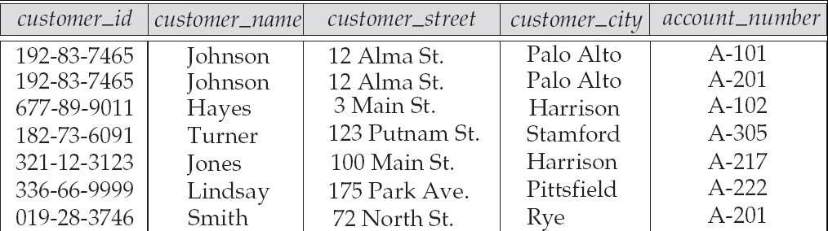
Relational Model
Example of tabular data in the relational model
Attributes
Neeti Taneja
DBMS
ACSE0506
Unit-1

Slide 91
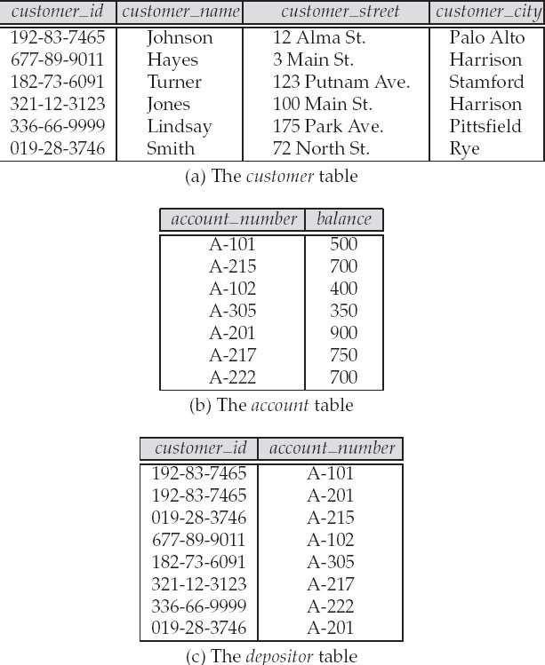
A Sample Relational Database
Neeti Taneja
DBMS
ACSE0506
Unit-1

Slide 92
Short Quiz
After groups have been established, SQL applies predicates in the
clause, allowing aggregate functions to be used.
Where
Having
Group by
With
Why the following statement is erroneous?
SELECT dept_name, ID, avg (salary) FROM instructor GROUP BY dept_name;
Dept_id should not be used in group by clause
Group by clause is not valid in this query
Avg(salary) should not be selected
None
Neeti Taneja
DBMS
ACSE0506
Unit-1

Slide 93
Topic- ER Model Objective
An entity relationship diagram gives a snapshot of how these entities relate to each other. You could call it the blueprint that underpins your business architecture, offering a visual representation of the relationships between different sets of data (entities).
An Entity Relationship (ER) Diagram is a type of flowchart
that illustrates how “entities” such as people, objects or concepts relate to each other within a system.
Neeti Taneja
DBMS
ACSE0506
Unit-1

Slide 94
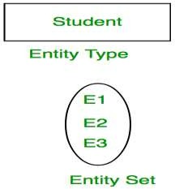
Introduction of ER Model
A database can be modeled as:
a collection of entities,
relationship among entities.
An entity is an object that exists and is distinguishable from other objects.
Example: specific person, company, event, plant
Entities have attributes
Example: people have names and addresses
An entity set is a set of entities of the same type that share the same properties.
Example: set of all persons, companies, trees, holidays
Neeti Taneja DBMS ACSE0506 Unit-1

Slide 95
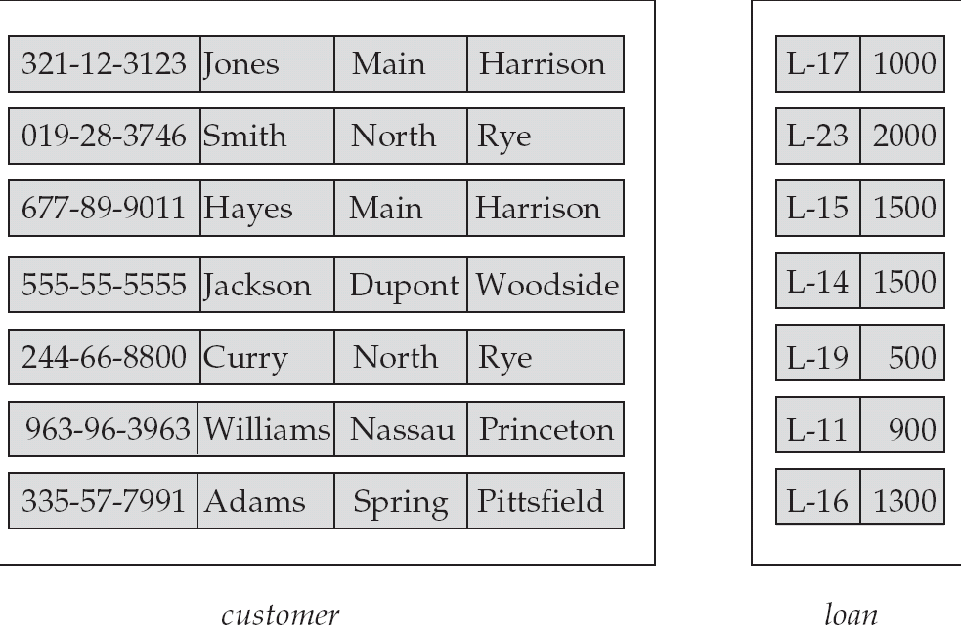
Entity Sets customer and loan
customer_id | customer_ | customer_ customer_ | loan_ | amount
 | name | street city | number
Neeti Taneja
DBMS
ACSE0506
Unit-1

Slide 96

Attributes
An entity is represented by a set of attributes, that is descriptive
properties possessed by all members of an entity set.
Example: customer= (customer_id, customer_name, customer_street, customer_city )
loan = (loan_number, amount )
In ER diagram, attribute is represented by an oval.
Domain – the set of permitted values for each attribute
Neeti Taneja
DBMS
ACSE0506
Unit-1

Slide 97
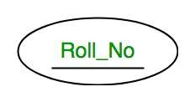
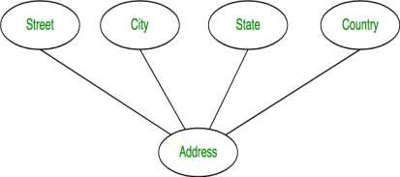
Attribute Type
Key Attribute – The attribute which uniquely identifies each entity in the entity set is called key attribute. For example, Roll_No will be unique for each student. In ER diagram, key attribute is represented by an oval with underlying lines.
Composite Attribute – An attribute composed of many other attribute is called as composite attribute. For example, Address attribute of student Entity type consists of Street, City, State, and Country. In ER diagram, composite attribute is represented by an oval comprising of ovals.
Neeti Taneja
DBMS
ACSE0506
Unit-1
97

Slide 98


Attribute Type
Multivalued Attribute – An attribute consisting more than one value for a given entity. For example, Phone_No (can be more than one for a given student). In ER diagram, multivalued attribute is represented by double oval.
Derived Attribute – An attribute which can be derived from other attributes of the entity type is known as derived attribute. e.g.; Age (can be derived from DOB). In ER diagram, derived attribute is represented by dashed oval.
Neeti Taneja
DBMS
ACSE0506
Unit-1
98

Slide 99
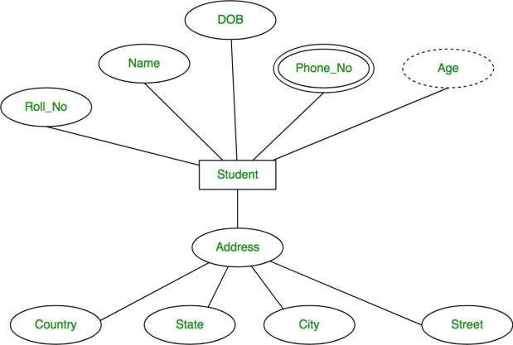
Attribute Type
The complete
represented as:
entity type Student with its attributes can be
Neeti Taneja
DBMS
ACSE0506
Unit-1
99

Slide 100
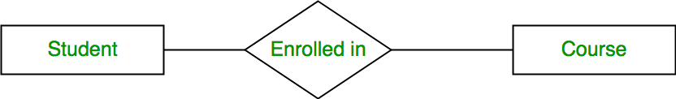
Relationship Type
A relationship type represents the association between entity
types.
For example, ‘Enrolled in’ is a relationship type that exists between entity type Student and Course.
In ER diagram, relationship type is represented by a diamond and connecting the entities with lines.
100
Neeti Taneja
DBMS
ACSE0506
Unit-1

Slide 101
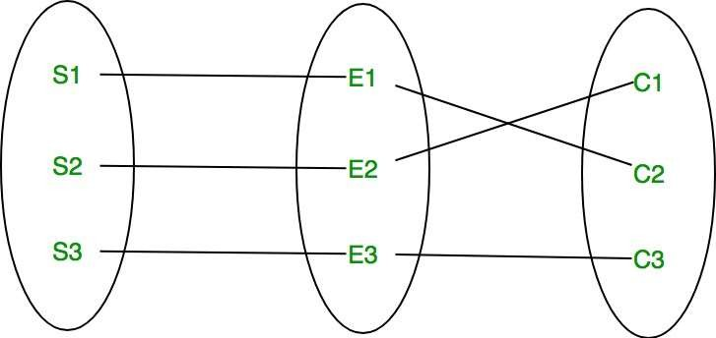
Relationship Set
A set of relationships of same type is known as relationship set.
The following relationship set depicts S1 is enrolled in C2, S2 is
enrolled in C1 and S3 is enrolled in C3.
Neeti Taneja
DBMS
ACSE0506
Unit-1
101

Slide 102
Degree of Relationship Set
The number of different entity sets participating in a relationship
set is called as degree of a relationship set.
Unary Relationship
Binary Relationship
n-ary Relationship
Neeti Taneja
DBMS
ACSE0506
Unit-1
102

Slide 103
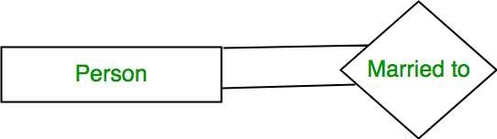
Unary Relationship
When there is only ONE entity set participating in a relation, the
relationship is called as unary relationship.
For example, one person is married to only one person.
Neeti Taneja
DBMS
ACSE0506
Unit-1
103

Slide 104
Binary Relationship
When there are TWO entities set participating in a relation, the
relationship is called as binary relationship.
For example, Student is enrolled in Course.
Neeti Taneja
DBMS
ACSE0506
Unit-1
104

Slide 105
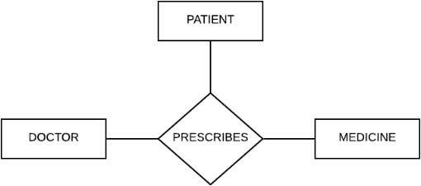
n-ary Relationship
When there are n entities set participating in a relation, the
relationship is called as n-ary relationship.
Neeti Taneja
DBMS
ACSE0506
Unit-1
105

Slide 106
Mapping Cardinality
The number of times an entity of an entity set participates in a
relationship set is known as cardinality.
Cardinality can be of different types:
One to one
One to many
Many to one
Many to many
Neeti Taneja
DBMS
ACSE0506
Unit-1
106

Slide 107
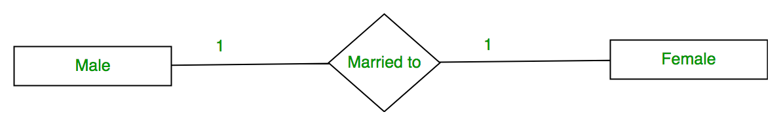
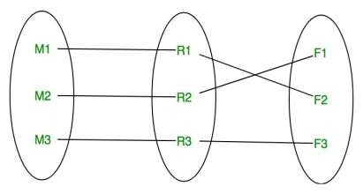
One to one
When each entity in each entity set can take part only once in the relationship, the cardinality is one to one. Let us assume that a male can marry to one female and a female can marry to one male. So the relationship will be one to one.
Using Sets, it can be represented as:
Neeti Taneja
DBMS
ACSE0506
Unit-1
107

Slide 108
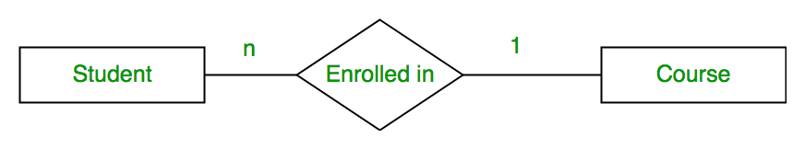
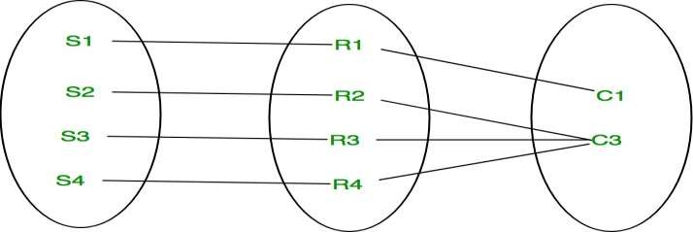
Many to one
When entities in one entity set can take part only once in the relationship set and entities in other entity set can take part more than once in the relationship set, cardinality is many to one
Using Sets, it can be represented as:
Neeti Taneja
DBMS
ACSE0506
Unit-1
107

Slide 109
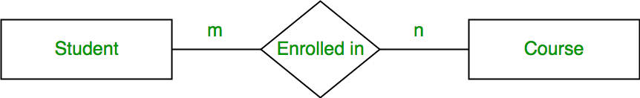
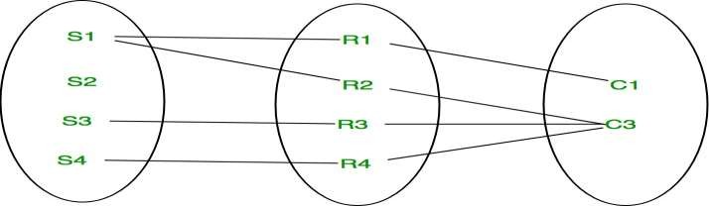
Many to many
When entities in all entity sets can take part more than once in the relationship cardinality is many to many. Let us assume that a student can take more than one course and one course can be taken by many students. So the relationship will be many to many.
Using sets, it can be represented as:
Neeti Taneja
DBMS
ACSE0506
109

Slide 110
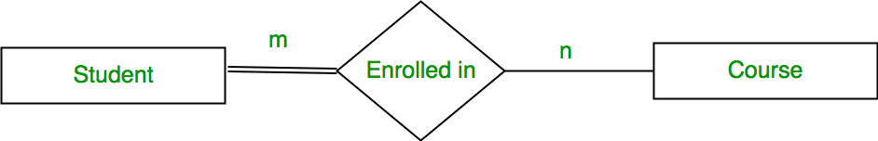
Participation Constraint
Total Participation – Each entity in the entity set must participate in the relationship. If each student must enroll in a course, the participation of student will be total. Total participation is shown by double line in ER diagram.
Partial Participation – The entity in the entity set may or may NOT participate in the relationship. If some courses are not enrolled by any of the student, the participation of course will be partial.
Neeti Taneja
DBMS
ACSE0506
Unit-1
110

Slide 111
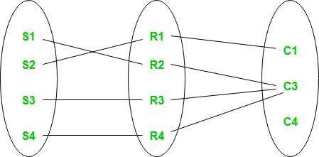
Participation Constraint (contd..)
Using set, it can be represented as
Every student in Student
Entity set is participating in relationship
but there exists a course
C4 which is not taking part in the
relationship.
Neeti Taneja
DBMS
ACSE0506
Unit-1
111

Slide 112
Weak Entity Type & Identifying Relationship
An entity type has a key attribute which uniquely identifies each
entity in the entity set.
But there exists some entity type for which key attribute can’t be defined. These are called Weak Entity type.
For example, A company may store the information of dependents (Parents, Children, Spouse) of an Employee.
But the dependents don’t have existence without the employee.
So Dependent will be weak entity type and Employee will be Identifying Entity type for Dependent.
Neeti Taneja
DBMS
ACSE0506
Unit-1
112

Slide 113
Weak Entity Type Vs Strong Entity Type
An entity type should have a key attribute which uniquely identifies each entity in the entity set, but there exists some entity type for which key attribute can’t be defined. These are called Weak Entity type.
The entity sets which do not have sufficient attributes to form a primary
key are known as weak entity sets and the entity sets which have a primary key are known as strong entity sets.
As the weak entities do not have any primary key, they cannot be identified on their own, so they depend on some other entity (known as owner entity). The weak entities have total participation constraints(existence dependency) in its identifying relationship with owner entity.
Weak entity types have partial keys. Partial Keys are set of attributes with the help of which the tuples of the weak entities can be distinguished and identified.
Note – Weak entity always has total participation but Strong entity may not have total participation.
12/23/2024
NEETI TANEJA
DBMS
Unit-1

Slide 114
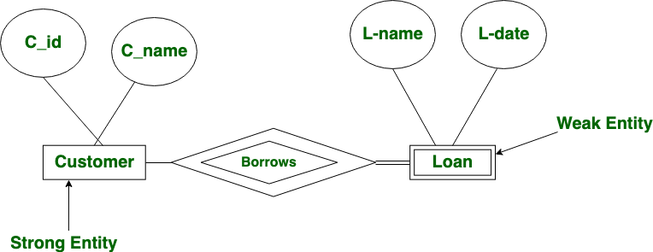
Weak Entity Type Vs Strong Entity Type
Weak entity depends on strong entity to ensure the existence of weak entity. Like strong entity, weak entity does not have any primary key, It has partial discriminator key. Weak entity is represented by double rectangle. The relation between one strong and one weak entity is represented by double diamond.
12/23/2024
NEETI TANEJA
DBMS
Unit-1

Slide 115
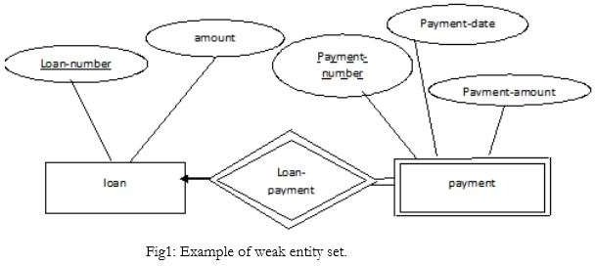
Weak Entity Type
In the below ER Diagram, ‘Payment’ is the weak entity. ‘Loan Payment’ is the identifying relationship and ‘Payment Number’ is the partial key. Primary Key of the Loan along with the partial key would be used to identify the records.
12/23/2024
NEETI TANEJA
DBMS
Unit-1

Slide 116
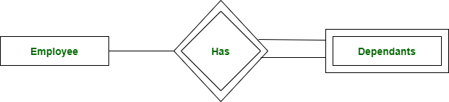
Weak Entity Type & Identifying Relationship
A weak entity type is represented by a double rectangle. The participation of weak entity type is always total. The relationship between weak entity type and its identifying strong entity type is called identifying relationship and it is represented by double diamond.
Neeti Taneja
DBMS
ACSE0506
116

Slide 117
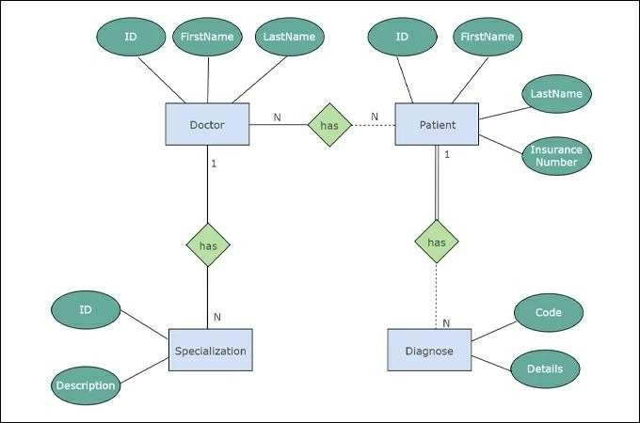
Example of ER Diagram
Neeti Taneja
DBMS
ACSE0506
Unit-1
117

Slide 118
Example of ER Diagram
Draw an ER Diagram:
Consider the following set of requirements for a Bank Database: "A large bank has several branches at different places. Each branch maintains the account details of the customers. The customers may open joint as well as single accounts. The bank also provides the loan to the customer for different purposes. Bank keeps record of each transaction by the customer to his account. All of the branches have employees and some employees are managers."
Neeti Taneja DBMS ACSE0506 Unit-1
118

Slide 119
Keys in DBMS
KEYS in DBMS is an attribute or set of attributes which helps you to
identify a row(tuple) in a relation(table).
They allow you to find the relation between two tables.
Keys help you uniquely identify a row in a table by a combination of one or more columns in that table.
Example:-
Employee ID | FirstName | LastName
11 | Andrew | Johnson
22 | Tom | Wood
33 | Alex | Hale
In the above-given example, employee ID is a primary key because it uniquely identifies an employee record. In this table, no other employee can have the same employee ID.
Neeti Taneja
DBMS
ACSE0506
Unit-1
119

Slide 120
Why we need a Key?
Here are some reasons for using SQL key in the DBMS system.
Keys help you to identify any row of data in a table.
In a real-world application, a table could contain thousands of records. Moreover, the records could be duplicated.
Keys in RDBMS ensure that you can uniquely identify a table record
despite these challenges.
Allows you to establish a relationship between and identify the relation between tables
Help you to enforce identity and integrity in the relationship.
Neeti Taneja
DBMS
ACSE0506
Unit-1
120

Slide 121
Types of Keys in DBMS
There are mainly Eight different types of Keys in DBMS and each key
has it’s different functionality:
Super Key – A super key is a group of single or multiple keys which identifies rows in a table.
Candidate Key – is a set of attributes that uniquely identify tuples in a table. Candidate Key is a super key with no repeated attributes.
Primary Key – is a column or group of columns in a table that uniquely identify every row in that table.
Alternate Key – is a column or group of columns in a table that
uniquely identify every row in that table.
Neeti Taneja
DBMS
ACSE0506

Slide 122
Types of Keys in DBMS (contd..)
Foreign Key – is a column that creates a relationship between two tables. The purpose of Foreign keys is to maintain data integrity and allow navigation between two different instances of an entity.
Compound Key – has two or more attributes that allow you to uniquely recognize a specific record. It is possible that each column may not be unique by itself within the database.
Composite Key – is a combination of two or more columns that uniquely identify rows in a table. The combination of columns guarantees uniqueness, though individual uniqueness is not guaranteed.
Surrogate Key – An artificial key which aims to uniquely identify each record is called a surrogate key. These kind of key are unique because they are created when you don’t have any natural primary key.
Neeti Taneja
DBMS
ACSE0506
Unit-1

Slide 123
Super key
A superkey is a group of single or multiple keys which identifies rows in a table. A Super key may have additional attributes that are not needed for unique identification.
Example:
EmpSSN | EmpNum | Empname
9812345098 | AB05 | Shown
9876512345 | AB06 | Roslyn
199937890 | AB07 | James
In the
above-given example, EmpSSN and EmpNum name are
superkeys.
Neeti Taneja
DBMS
ACSE0506
Unit-1

Slide 124
Primary Key
PRIMARY KEY in DBMS is a column or group of columns in a table that uniquely identify every row in that table. The Primary Key can’t be a duplicate meaning the same value can’t appear more than once in the table. A table cannot have more than one primary key.
Example:
StudID | Roll No | First Name | LastName | Email
1 | 11 | Tom | Price | abc@gmail.com
2 | 12 | Nick | Wright | xyz@gmail.com
3 | 13 | Dana | Natan | mno@yahoo.com
In the following example, StudID is a Primary Key.
Neeti Taneja
DBMS
ACSE0506
Unit-1

Slide 125
Primary Key (contd..)
Rules for defining Primary key:
Two rows can’t have the same primary key value
It must for every row to have a primary key value.
The primary key field cannot be null.
The value in a primary key column can never be modified or
updated if any foreign key refers to that primary key.
Neeti Taneja
DBMS
ACSE0506
Unit-1

Slide 126
Primary Key
Primary Key
Customers
12/23/2024
NEETI TANEJA
DBMS
Unit-1

Slide 127
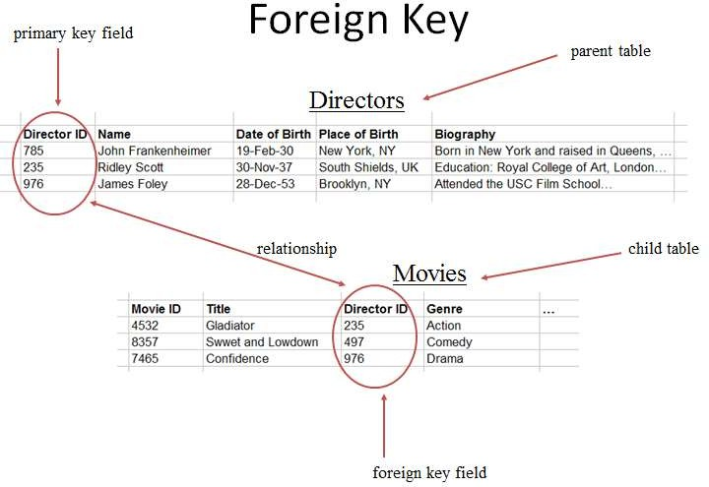
Foreign Key
12/23/2024
NEETI TANEJA
DBMS
Unit-1

Slide 128
Alternate key
ALTERNATE KEYS is a column or group of columns in a table that uniquely identify every row in that table. A table can have multiple choices for a primary key but only one can be set as the primary key. All the keys which are not primary key are called an Alternate Key.
Example:
StudID | Roll No | First Name | LastName | Email
1 | 11 | Tom | Price | abc@gmail.com
2 | 12 | Nick | Wright | xyz@gmail.com
3 | 13 | Dana | Natan | mno@yahoo.com
In this table, StudID, Roll No, Email are qualified to become a primary key. But since StudID is the primary key, Roll No, Email becomes the alternative key.
Neeti Taneja
DBMS
ACSE0506
Unit-1
128

Slide 129
Candidate Key
CANDIDATE KEY in SQL is a set of attributes that uniquely identify tuples in a table. Candidate Key is a super key with no repeated attributes. The Primary key should be selected from the candidate keys. Every table must have at least a single candidate key. A table can have multiple candidate keys but only a single primary key.
Example:
StudID | Roll No | First Name | LastName | Email
1 | 11 | Tom | Price | abc@gmail.com
2 | 12 | Nick | Wright | xyz@gmail.com
3 | 13 | Dana | Natan | mno@yahoo.com
Candidate key Example: In the given table Stud ID, Roll No, and email are candidate keys which help us to uniquely identify the student record in the table.
Neeti Taneja DBMS ACSE0506 Unit-1

Slide 130
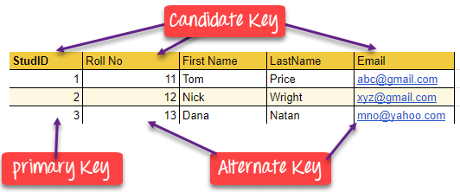
Candidate Key (contd..)
Properties of Candidate key:
It must contain unique values
Candidate key in SQL may have multiple attributes
Must not contain null values
It should contain minimum fields to ensure uniqueness
Uniquely identify each record in a table
Neeti Taneja
DBMS
ACSE0506
Unit-1

Slide 131
Foreign key
FOREIGN KEY is a column that creates a relationship between two tables. The purpose of Foreign keys is to maintain data integrity and allow navigation between two different instances of an entity. It acts as a cross-reference between two tables as it references the primary key of another table.
Example:
DeptCode | DeptName
001 | Science
002 | English
005 | Computer
Teacher ID | Fname | Lname
B002 | David | Warner
B017 | Sara | Joseph
B009 | Mike | Brunton
Neeti Taneja
DBMS
ACSE0506
Unit-1

Slide 132
Foreign key (contd..)
In this example, we have two tables, teacher and department in a school. However, there is no way to see which teacher work in which department.
In this table, adding the foreign key Deptcode to the Teacher, we can create a relationship between the two tables.
Teacher ID | DeptCode | Fname | Lname
B002 | 002 | David | Warner
B017 | 002 | Sara | Joseph
B009 | 001 | Mike | Brunton
This concept is also known as Referential Integrity.
Neeti Taneja
DBMS
ACSE0506
Unit-1

Slide 133
Compound key
COMPOUND KEY has two or more attributes that allow you to uniquely recognize a specific record. It is possible that each column may not be unique by itself within the database. However, when combined with
the other column become unique.
Example:
or columns the combination of composite keys
OrderNo | PorductID | Product Name | Quantity
B005 | JAP102459 | Mouse | 5
B005 | DKT321573 | USB | 10
B005 | OMG446789 | LCD Monitor | 20
B004 | DKT321573 | USB | 15
B002 | OMG446789 | Laser Printer | 3
In this example, OrderNo and ProductID can’t be a primary key as it does not uniquely identify a record. However, a compound key of Order No and Product ID could be used as it uniquely identified each record.
Neeti Taneja DBMS ACSE0506 Unit-1 133

Slide 134
Composite key
COMPOSITE KEY is a combination of two or more columns that uniquely identify rows in a table. The combination of columns guarantees uniqueness, though individually uniqueness is not guaranteed. Hence, they are combined to uniquely identify records in a table.
The difference between compound and the composite key is that any part of the compound key can be a foreign key, but the composite key may or maybe not a part of the foreign key.
Neeti Taneja
DBMS
ACSE0506
Unit-1
134

Slide 135
Surrogate key
SURROGATE KEYS is An artificial key which aims to uniquely identify
each record is called a surrogate key.
This kind of partial key in dbms is unique because it is created when you don’t have any natural primary key.
They do not lend any meaning to the data in the table. Surrogate
key in DBMS is usually an integer.
A surrogate key is a value generated right before the record is inserted into a table.
Surrogate keys in sql are allowed when
No property has the parameter of the primary key.
In the table when the primary key is too big or complicated.
Neeti Taneja
DBMS
ACSE0506
Unit-1
135

Slide 136
Surrogate key (contd..)
Example:
Fname | Lastname | Start Time | End Time
Anne | Smith | 09:00 | 18:00
Jack | Francis | 08:00 | 17:00
Anna | McLean | 11:00 | 20:00
Shown | Willam | 14:00 | 23:00
Above, given example, shown shift timings of the different employee. In this example, a surrogate key is needed to uniquely identify each employee.
136
Neeti Taneja
DBMS
ACSE0506
Unit-1

Slide 137
Difference b/w Primary key & Foreign key
Primary Key | Foreign Key
Helps you to uniquely identify a record in the table. | It is a field in the table that is the primary key of another table.
Primary Key never accept null values. | A foreign key may accept multiple null values.
Primary key is a clustered index and data in the DBMS table are physically organized in the sequence of the clustered index. | A foreign key cannot automatically create an index, clustered or non-clustered. However, you can manually create an index on the foreign key.
You can have the single Primary key in a table. | You can have multiple foreign keys in a table.
Neeti Taneja
DBMS
ACSE0506
Unit-1

Slide 138
Short Quiz
Q. Given the basic ER and relational models, which of the following is INCORRECT?
answer choices
An attribute of an entity can have more than one value.
An attribute of an entity can be composite.
In a row of a relational table, an attribute can have more than one value.
In a row of a relationaltable, an attribute can have exactly one value or a NULL value.
Q. Which type of entity cannot exist in the database unless another type of entity also exists in the database, but does not require that the identifier of that other entity be included as part of its own identifier?
Weak entity
Strong entity
ID-dependent entity
ID- independent entity
Neeti Taneja
DBMS
ACSE0506
Unit-1

Slide 139
Generalization, Specialization and Aggregation Objective
Generalization of Entities helps in establishing relationships between the tables, as they have common attributes to be identified. It makes the structuring of the database management simpler and easy to identify all the relevant attributes.
Specialization helps in defining the set of subclasses of the entity type. Also, it helps in establishing extra specific attributes with all subclasses and added specific relationship types between each subclass and the other entity types or the other subclasses.
Inheritance is an important feature of Generalization and Specialization. It allows lower-level entities to inherit the attributes of higher-level entities. For example, the attributes of a Person class such as name, age, and gender
can be inherited by lower-level entities such as Student or Teacher.
Neeti Taneja
DBMS
ACSE0506
Unit-1
139

Slide 140
Generalization
Generalization is the process of extracting common properties from a set of entities and create a generalized entity from it.
It is a bottom-up approach in which two or more entities can be generalized to a higher level entity if they have some attributes in common.
For Example, STUDENT and FACULTY can be generalized to a higher level entity called PERSON as shown in Figure.
In this case, common attributes like P_NAME, P_ADD become part of higher entity (PERSON) and specialized attributes like S_FEE become part of specialized entity (STUDENT).
Neeti Taneja
DBMS
ACSE0506
140

Slide 141
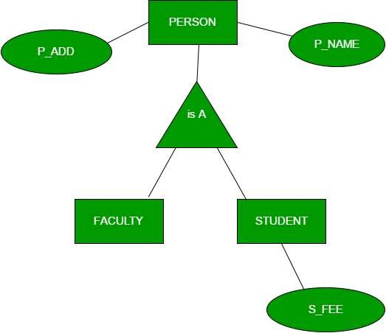
Example:
Neeti Taneja
DBMS
ACSE0506
141

Slide 142
Specialization
In specialization, an entity is divided into sub-entities based on their
characteristics.
It is a top-down approach where higher level entity is specialized into two or more lower level entities.
For Example, EMPLOYEE entity in an Employee management system can be specialized into DEVELOPER, TESTER etc. as shown in Figure.
In this case, common attributes like E_NAME, E_SAL etc. become part of higher entity (EMPLOYEE) and specialized attributes like TES_TYPE become part of specialized entity (TESTER).
Neeti Taneja
DBMS
ACSE0506
142

Slide 143
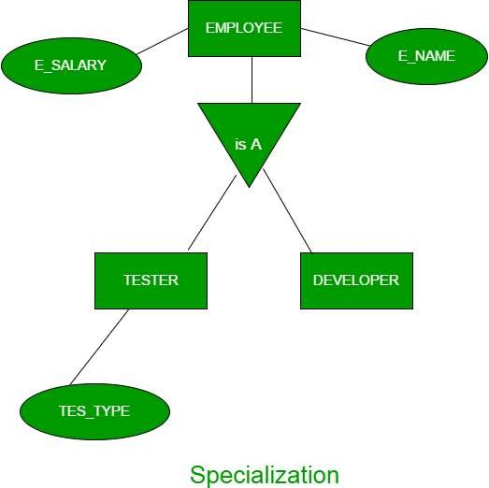
Example:
Neeti Taneja
DBMS
ACSE0506
143

Slide 144
Aggregation
An ER diagram is not capable of representing relationship between an entity and a relationship which may be required in some scenarios.
In those cases, a relationship with its corresponding entities is
aggregated into a higher level entity.
Aggregation is an abstraction through which we can represent relationships as higher level entity sets.
For Example, Employee working for a project may require some
machinery. So,
relationship
REQUIRE relationship is needed between
WORKS_FOR and entity MACHINERY. Using
aggregation, WORKS_FOR relationship with its entities EMPLOYEE and PROJECT is aggregated into single entity and relationship REQUIRE is created between aggregated entity and MACHINERY.
Neeti Taneja
DBMS
ACSE0506
144

Slide 145
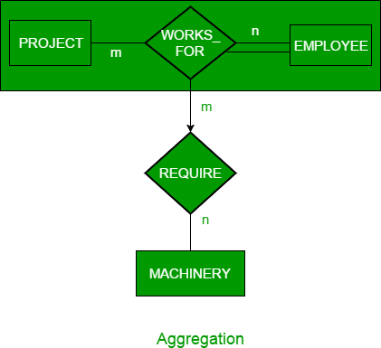
Example:
Neeti Taneja
DBMS
ACSE0506
145

Slide 146
Reduction of an ER diagrams to tables Objectives
Mapping an Entity Relationship (ER) model gives a good overview of the design of a system with the goal of making the system easier to understand at a technical level.
The ER diagrams can be mapped to a relation schema, which means we can clearly display the relationship between its members.
3. An Entity Relationship (ER) Diagram is a type of flowchart
that
illustrates how “entities” such as people, objects or concepts each other within a system.
relate to
Neeti Taneja
DBMS
ACSE0506
145

Slide 147
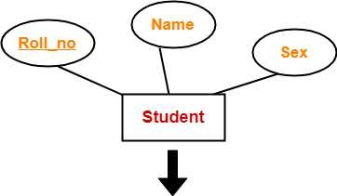
Reduction of an ER diagrams to tables Rule-01
Rule-01: For Strong Entity Set With Only Simple Attributes
A strong entity set with only simple attributes will require only
one table in relational model.
Attributes of the table will be the attributes of the entity set.
The primary key of the table will be the key attribute of
the entity set.
Schema : Student ( Roll_no , Name , Sex )
Neeti Taneja
DBMS
ACSE0506
147

Slide 148
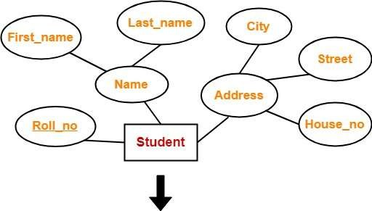
Rule-02
Rule-02: For Strong Entity Set With Composite Attributes
A strong entity set with any number of composite attributes will require only one table in relational model.
While conversion, simple attributes of the composite attributes are
taken into account and not the composite attribute itself.
Schema : Student ( Roll_no , First_name , Last_name , House_no , Street , City )
Neeti Taneja
DBMS
ACSE0506
147

Slide 149
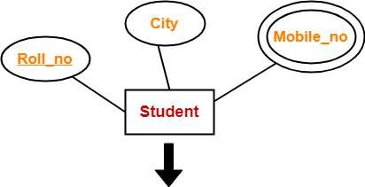
Rule-02
Rule-03: For Strong Entity Set With Multi Valued Attributes
A strong entity set with any number of multi valued attributes will require two tables in relational model.
One table will contain all the simple attributes with the primary key.
Other table will contain the primary key and all the multi valued attributes.
•
Roll_no | City
Roll_no | Mobile_no
Neeti Taneja
DBMS
ACSE0506
149

Slide 150
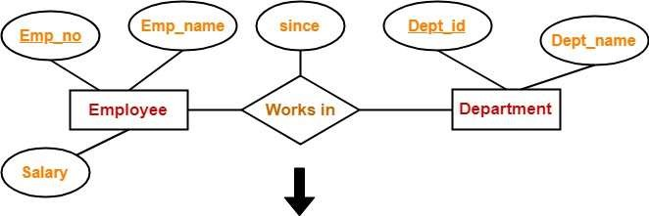
RULE-04
Rule-04: Translating Relationship Set into a Table
A relationship set will require one table in the relational model.
Attributes of the table are-
Primary key attributes of the participating entity sets
Its own descriptive attributes if any.
Set of non-descriptive attributes will be the primary key.
Schema : Works in ( Emp_no , Dept_id , since )
Neeti Taneja DBMS ACSE0506

Slide 151
RULE-05
Rule-05: For Binary Relationships With Cardinality Ratios
The following four cases are possible-
Case-01: Binary relationship with cardinality ratio m:n
Case-02: Binary relationship with cardinality ratio 1:n
Case-03: Binary relationship with cardinality ratio m:1
Case-04: Binary relationship with cardinality ratio 1:1
•
Neeti Taneja
DBMS
ACSE0506

Slide 152
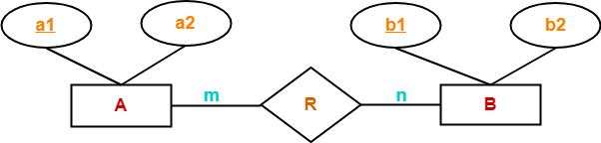
RULE-05 (contd..)
Case-01: For Binary Relationship With Cardinality Ratio m:n
Here, three tables will be required-
A ( a1 , a2 )
R ( a1 , b1 )
B ( b1 , b2 )
Neeti Taneja
DBMS
ACSE0506

Slide 153
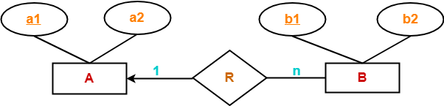
RULE-05 (contd..)
Case-02: For Binary Relationship With Cardinality Ratio 1:n
Here, two tables will be required-
A ( a1 , a2 )
BR ( a1 , b1 , b2 )
NOTE- Here, combined table will be drawn for the entity set B and relationship set R.
Neeti Taneja
DBMS
ACSE0506

Slide 154

RULE-05 (contd..)
Case-03: For Binary Relationship With Cardinality Ratio m:1
Here, two tables will be required-
AR ( a1 , a2 , b1 )
B ( b1 , b2 )
NOTE- Here, combined table will be drawn for the entity set A and relationship set R.
Neeti Taneja
DBMS
ACSE0506

Slide 155

RULE-05 (contd..)
Case-04: For Binary Relationship With Cardinality Ratio 1:1
Here, two tables will be required. Either combine ‘R’ with ‘A’ or ‘B’
Way-01:
AR ( a1 , a2 , b1 )
B ( b1 , b2 )
Way-02:
A ( a1 , a2 )
BR ( a1 , b1 , b2 )
Neeti Taneja
DBMS
ACSE0506

Slide 156
RULE-06
Rule-06: For Binary Relationship With Both Cardinality Constraints
and Participation Constraints-
Case-01: For Binary Relationship With Cardinality Constraint and Total Participation Constraint From One Side
Case-02: For Binary Relationship With Cardinality Constraint and Total Participation Constraint From Both Sides-
Neeti Taneja
DBMS
ACSE0506

Slide 157

RULE-06 (contd..)
Case-01: For Binary Relationship With Cardinality Total Participation Constraint From One Side
Constraint and
Because cardinality ratio = 1 : n , so we will combine the entity set B and relationship set R.
Then, two tables will be required-
A ( a1 , a2 )
BR ( a1 , b1 , b2 )
Because of total participation, foreign key a1 has acquired NOT NULL constraint, so it can’t be null now.
Neeti Taneja DBMS ACSE0506

Slide 158

RULE-06 (contd..)
Case-02: For Binary Relationship With Cardinality Constraint and
Total Participation Constraint From Both Sides
If there is a key constraint from both the sides of an entity set with total participation, then that binary relationship is represented using only single table.
Here, Only one table is required.
ARB ( a1 , a2 , b1 , b2 )
Neeti Taneja DBMS
ACSE0506
158

Slide 159

RULE-07
Rule-07: For Binary Relationship With Weak Entity Set
Weak entity set always appears in association with identifying relationship with total participation constraint.
Here, two tables will be required-
A ( a1 , a2 )
BR ( a1 , b1 , b2 )
Neeti Taneja
DBMS
ACSE0506

Slide 160
ER Diagram
Examples
Neeti Taneja
DBMS
ACSE0506

Slide 161

ER Diagram For Department
Neeti Taneja
DBMS
ACSE0506

Slide 162

ER Diagram for Company
Neeti Taneja
DBMS
ACSE0506

Slide 163
Extended ER Model
Enhanced ERD are high level models that represent the requirements and complexities of complex database.
In addition to ER model concepts EE-R includes −
Subclasses and Super classes.
Specialization and Generalization.
Category or union type.
Aggregation.
Neeti Taneja
DBMS
ACSE0506

Slide 164

Extended ER Model
Subclasses and Super Class
Neeti Taneja
DBMS
ACSE0506

Slide 165

Extended ER Model
Specialization and Generalization
Neeti Taneja
DBMS
ACSE0506

Slide 166

Extended ER Model
Category or Union
Relationship of one super or sub class with more than one super class.
Neeti Taneja
DBMS
ACSE0506
166

Slide 167

Extended ER Model
Aggregation
Represents relationship between a whole object and its component.
Neeti Taneja
DBMS
ACSE0506

Slide 168
Relationship of higher degree
Degree of Relationship
A degree of relationship represents the number of entity types
that are associated with a relationship.
Types of degree
based on the number of linked entity types, we have 4 types of degrees of relationships.
Unary
Binary
Ternary
N-ary
Neeti Taneja
DBMS
ACSE0506

Slide 169

Relationship of higher degree
Unary (Degree 1)
in a relation only one entity set is participating then such type of
relationship is known as a unary relationship.
Example: In a particular class, we have many students, there are monitors too. So, here class monitors are also students. Thus, we can say that only students are participating here. So the degree of such type of relationship is 1.
Neeti Taneja
DBMS
ACSE0506

Slide 170

Relationship of higher degree
Binary (Degree 2)
In a relation when two entity sets are participating then such type of relationship is known as a binary relationship. This is the most used relationship and one can easily be converted into a relational table.
Example: We have two entity types ‘Student’ and ‘ID’ where each ‘Student’ has his ‘ID’. So, here two entity types are associating, it is a binary relationship.
Also, one ‘Father’ can have many ‘daughters’ but each ‘daughter’ should belong to only one ‘father. it is a one-to-many binary relationship.
Neeti Taneja
DBMS
ACSE0506

Slide 171

Relationship of higher degree
Ternary (Degree 3)
Ternary relationship exists when there are three types of entity
and we call them a degree of relationship is 3.
Example: We have three entity types ‘Teacher’, ‘Course’, and ‘Class’. The relationship between these entities is defined as the teacher teaching a particular course, also the teacher teaches a particular class. So, here three entity types are associating we can say it is a ternary relationship.
Neeti Taneja
DBMS
ACSE0506

Slide 172

Relationship of higher degree
N-ary (n Degree)
an N-ary relationship exists when there are n types of entities. There is one limitation of the N-ary relationship, as there are many entities so it is very hard to convert into an entity, rational table. https://youtu.be/M4qZ5i1LL2o?si=M-YvPZ1Vp9KZK5Kn https://youtu.be/010_f2HKzJY?si=82Z1Qleud-bBduii
Example: We have 5 entities Teacher, Class, Location, Salary, Course. So,
here five entity types are associating we can say an n-ary relationship is 5.
Unit-1
172
Neeti Taneja
DBMS
ACSE0506

Slide 173
Summary of Conceptual Design
Conceptual design follows requirements analysis,
Yields a high-level description of data to be stored
ER model popular for conceptual design
Constructs are expressive, close to the way people think about their applications.
Basic constructs: entities, relationships, and attributes (of entities
and relationships).
Some additional constructs: weak entities, ISA hierarchies, and
aggregation.
Note: There are many variations on ER model.
Neeti Taneja
DBMS
ACSE0506

Slide 174
Summary of ER (Contd.)
ER design is subjective. There are often many ways to model a given scenario! Analyzing alternatives can be tricky, especially for a large enterprise. Common choices include:
– Entity vs. attribute, entity vs. relationship, binary or n-ary relationship, whether or not to use ISA hierarchies, and whether or not to use aggregation.
Ensuring good database design: resulting relational schema should be analyzed and refined further. FD information and normalization techniques are especially useful.
Neeti Taneja
DBMS
ACSE0506

Slide 175
Use Cases Videos
https://youtu.be/M4qZ5i1LL2o?si=M-YvPZ1Vp9KZK5Kn
https://youtu.be/010_f2HKzJY?si=82Z1Qleud-bBduii
Neeti Taneja
DBMS
ACSE0506

Slide 176
Topic Links
https://www.geeksforgeeks.org/last-minute-notes-dbms/
https://www.geeksforgeeks.org/quiz-corner-gq/#DBMS%20Mock%20Tests
https://www.geeksforgeeks.org/commonly-asked-dbms-interview-
questions/
https://www.geeksforgeeks.org/commonly-asked-dbms-interview- questions-set-2/
Neeti Taneja
DBMS
ACSE0506

Slide 177
Daily Quiz
Define Database System.
What do you understand by data independence?
Explain types of attributes in ER diagram.
What is generalization.
What do you understand by primary key?
Explain participation cardinality.
Explain Types of keys.
Differentiate between primary key and candidate key.
Neeti Taneja
DBMS
ACSE0506

Slide 178
MCQ s
The entity relationship set is represented in E-R diagram as
Double diamonds
Undivided rectangles
Dashed lines
Diamond
The Rectangles divided into two parts represents
Entity set
Relationship set
Attributes of a relationship set
Primary key
Neeti Taneja
DBMS
ACSE0506

Slide 179
MCQ s
An entity set that does not have sufficient attributes to form a
primary key is termed a
Strong entity set
Variant set
Weak entity set
Variable set
What term is used to refer to a specific record in your music database; for instance; information stored about a specific album?
Relation
Instance
Table
Column
Neeti Taneja
DBMS
ACSE0506

Slide 180
Glossary Questions
What are the features of Database language?
What is Data Independence in a database system?
Define database model.
What is SQL?
Enlist the various relationships of database.
Define DDL and DML.
Enlist some commands of DDL.
What are the key concepts of the Entity-Relationship (ER) Model in data modelling?
Neeti Taneja
DBMS
ACSE0506

Slide 181
Weekly Assignment
Define: Data, Database, and Database System.
What is data independence? What are differences between Logical
Data Independence and Physical Data Independence?
Give example of Simple, Composite, Single –valued and Multi-
valued attributes of an entity.
What is the difference between Generalization &
with respect to Database?
Specialization
What is difference between total and partial participation? Explain by suitable example.
Construct an E-R diagram for a hospital with a set of patients and a set of medical doctors. Associated with each patient, a log of the various tests and examinations conducted.
Neeti Taneja
DBMS
ACSE0506

Slide 182
Old Question Papers
http://www.aktuonline.com/papers/btech-cs-5-sem-data-base- management-system-KCS501-2020.pdf
http://www.aktuonline.com/papers/btech-cs-5-sem-database-
management-system-KCS-501-2018-19.pdf
http://www.aktuonline.com/papers/btech-cs-5-sem-database- management-system-ncs-502-2017-18.pdf
http://www.aktuonline.com/papers/btech-cs-5-sem-database-
management-system-ncs-502-2016-17.pdf
Neeti Taneja
DBMS
ACSE0506

Slide 183
Expected Questions for University Exam
Explain types of attributes in ER diagram.
Explain the difference between a weak and a strong entity set with
example.
Discuss three level of abstractions or DBMS.
Define constraint and its types in DBMS.
Compare Generalization, Specialization and aggregation with
schemas architecture of
suitable examples.
Draw overall structure of DBMS and explain its components in brief.
Construct an E-R diagram for a hospital with a set of patients and a set of medical doctors. Associated with each patient, a log of the various tests and examinations conducted.
Neeti Taneja
DBMS
ACSE0506
183

Slide 184
Recap of Unit
Knowledge of database architecture.
Knowledge of Entity Relationship model and its concepts.
Databse V/S File system.
Neeti Taneja
DBMS
ACSE0506
184

Slide 185



Neeti Taneja
DBMS
ACSE0506
185

